Slide 1
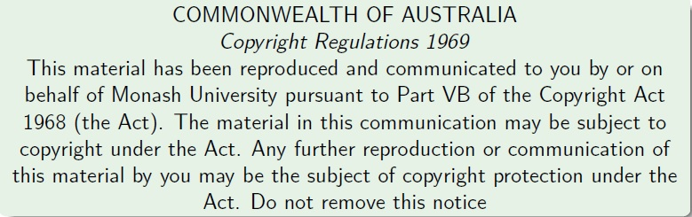
Faculty of Information Technology, Monash University

Slide 2
Design Principles (Summing up FIT2004)
Here are some broad strategies to (try to) solve algorithmic problems:
Look out for good invariants to exploit
Attempt to balance your work as much as possible
Do not repeat work (so, store and re-use!)
Use appropriate data structures
Try well-known problem solving strategies
Sometimes greed is good!
These are general guidelines. As always, there are many exceptions

Slide 3
Look out for good invariants to exploit
Here are some algorithms we considered in the unit that do precisely this!
Binary Search (Refer Week 2 lecture)
Sorting (Refer Lectures from Weeks 2 and 3)
Shortest Paths and Connectivity
Dijkstra’s algorithm (Refer Week 8 Lectures)
Floyd-Warshall algorithm (Refer Week 9 lectures)
Minimum Spanning Tree Algorithms (Refer Week 10 lectures)

Slide 4
Balance your work as much as possible
For problems that allow division of labour (eg. Divide and Conquer)
Try to divide work equally as much as possible
Merge sort achieves this
O(N log N)-time always!
Quick sort does not necessarily achieve this – depends on the choice of the pivot (Refer week 3)
Good pivots give O(N log N)-time
Bad pivots give O(N²)-time

Slide 5
Choose Data Structures with care
Certain data representations are more efficient than others for a given problem
Priority Queue in Dijkstra’s algorithm (Refer Week 8)
Union-Find data structure in Kruskal’s algorithm (refer Week 9)
Efficient Search and retrieval data structures of various kinds (Refer Weeks 5,6,7 lectures)

Slide 6
Don’t repeat work
Do not compute anything more than once (if there is room to store it for reuse)
Underpins Dynamic Programming strategy
Edit Distance (Refer Week 4 Lecture)
Knapsack Problem (Refer Week 4 Lecture)

Slide 7
Try well known problem solving strategies
Divide and Conquer (Refer Weeks 3, 4 lectures)
Dynamic Programming (Refer Weeks 4, 8, 9 lectures)

Slide 8
Sometimes greed is good
A greedy strategy is to make a “local” choice based on current information
Sometimes gives optimal solution, e.g.
Dijkstra’s single source shortest paths algorithm (Refer Week 8 Lectures)
Minimim Spanning Tree Algorithms – Prim’s and Kruskal’s (Refer Week 10 lectures) minimum spanning tree algorithm.
Greedy is sometimes a good heuristic!
Sometimes gives a “good” solution to a (combinatorial) problem even if not guaranteed optimal

Slide 9

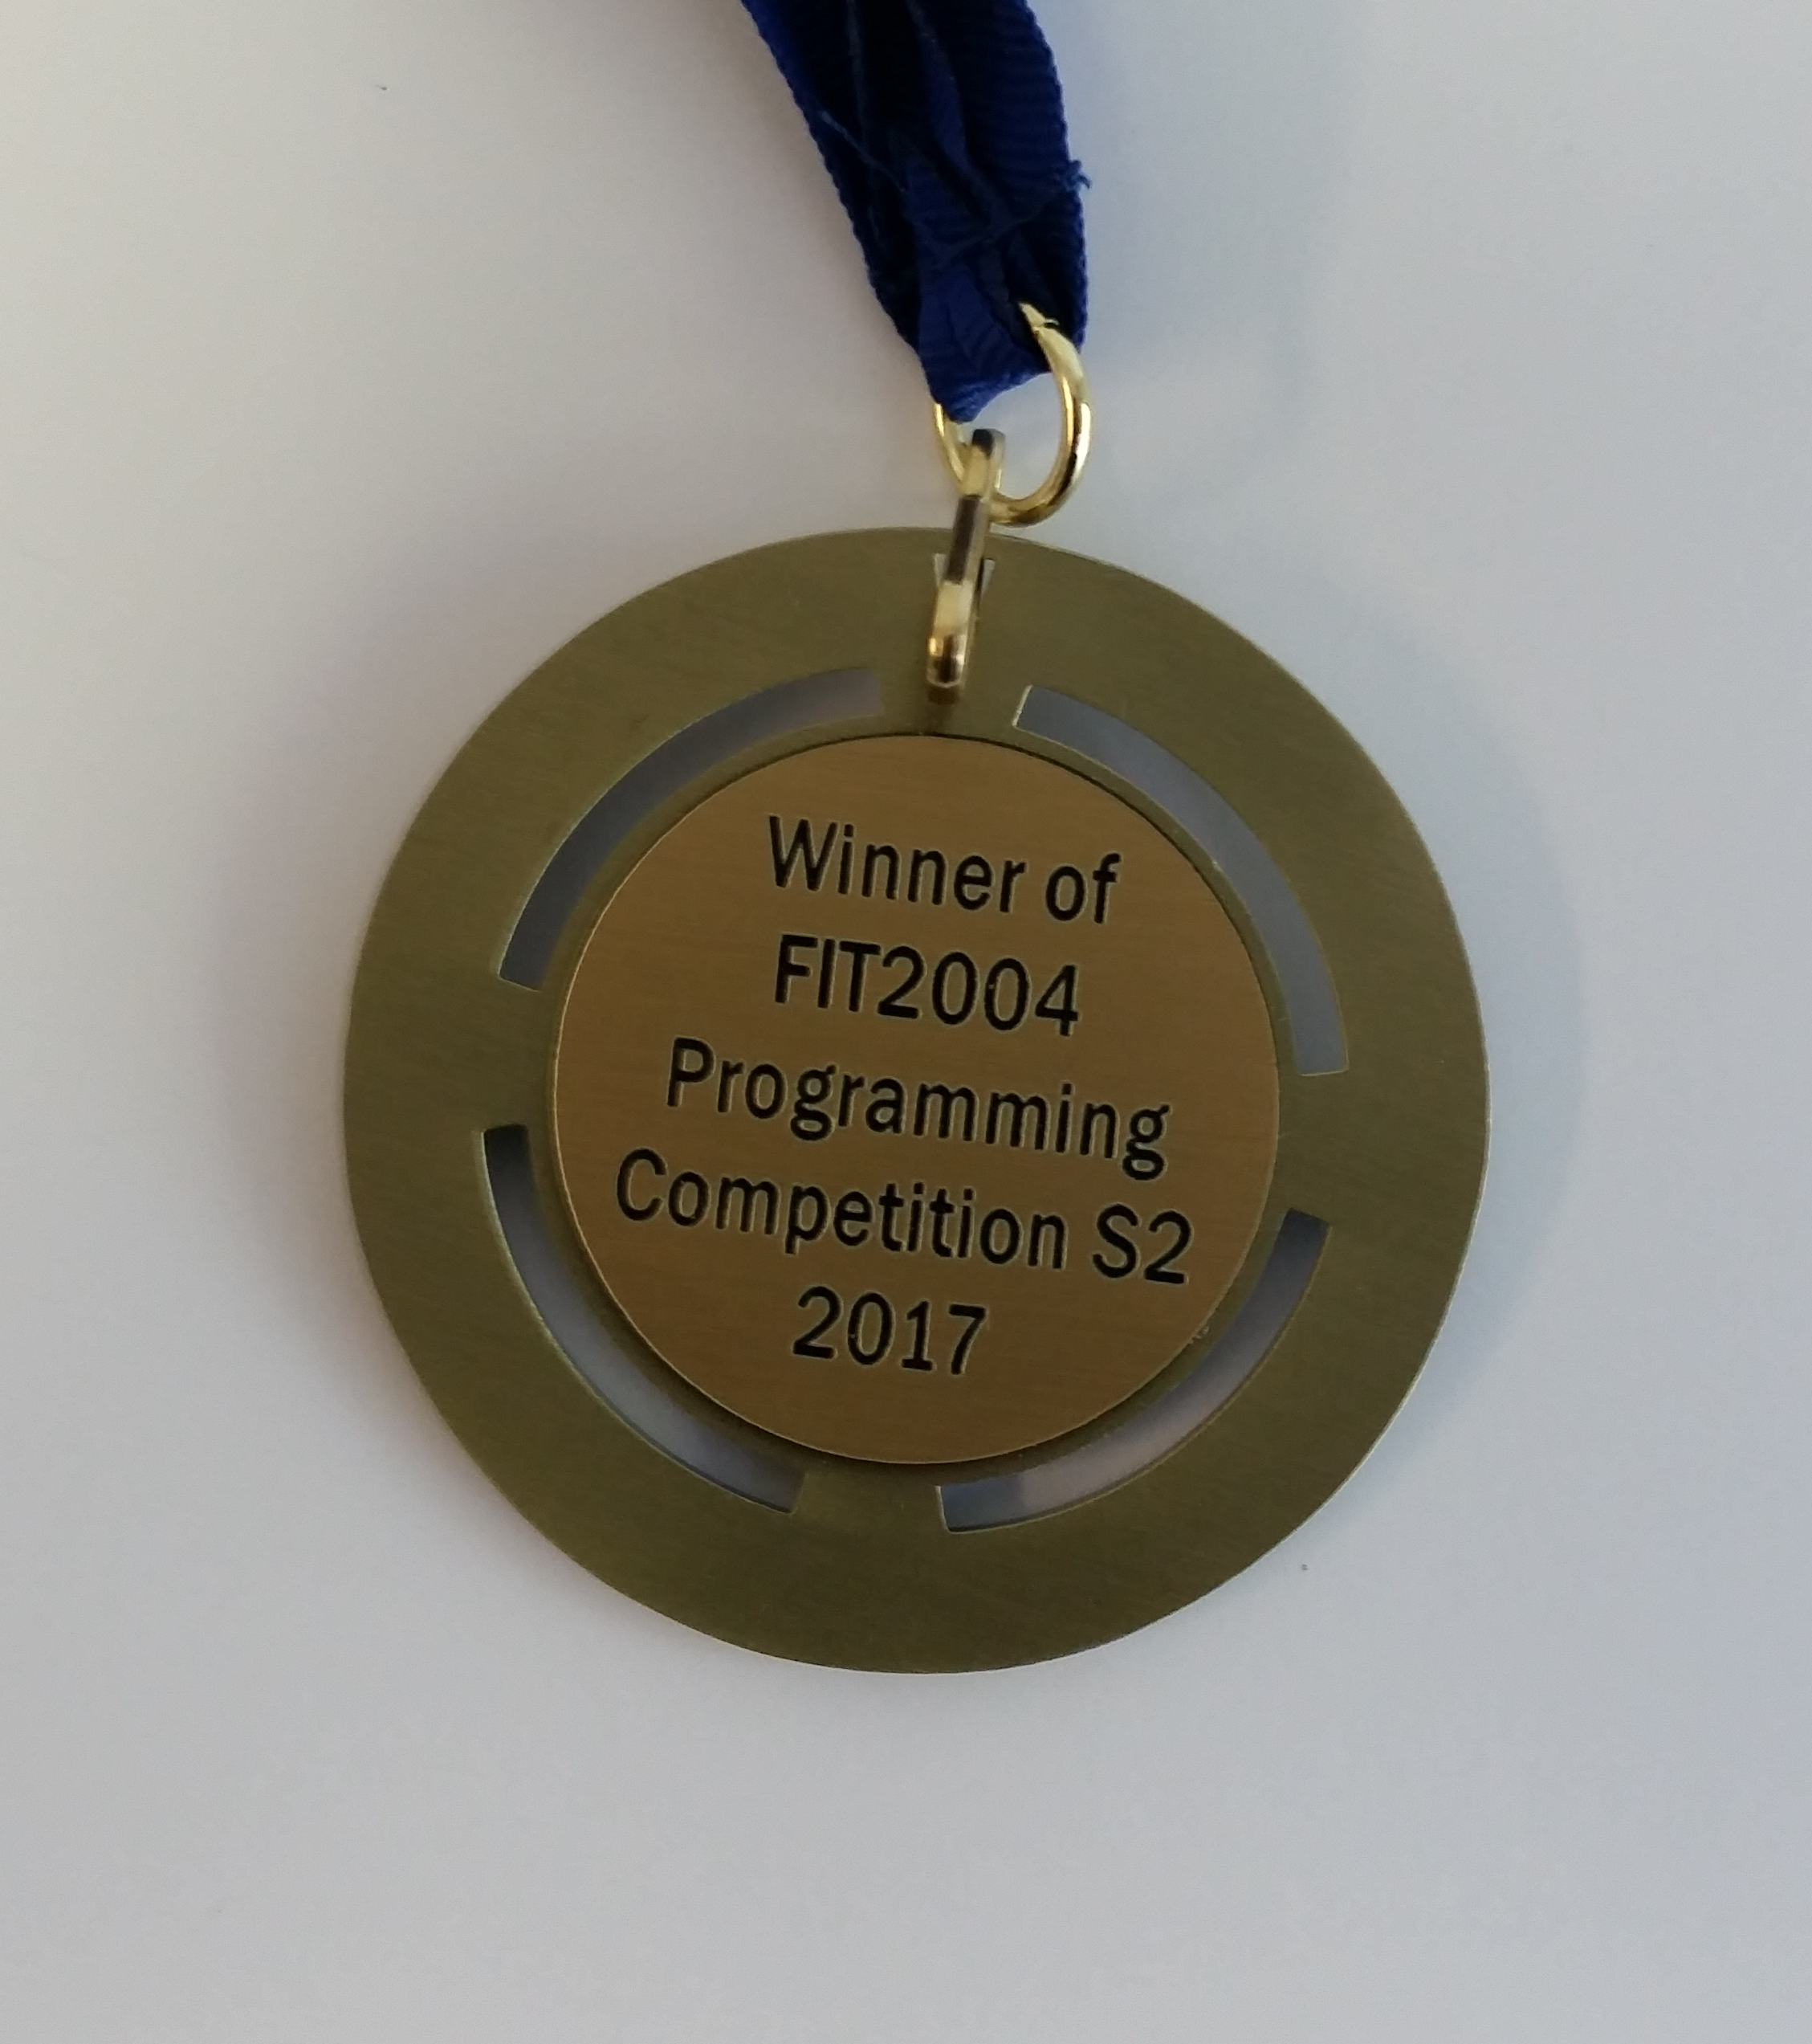
Programming Competition Winners
5th: Bryan Birchler
4th: Yanda Qu
3rd: Andrew Jakubowicz
2nd: Geng Feng
Champion: Thorsten Nielsen

Slide 10
Final Exam
Time allowed: 2 hours + 10 minutes reading time
Total Marks: 60
Exam is NOT open book
Question style similar to mid-semester tests – but do not try to guess what will be on the exam
In-semester hurdle: You need 16 out of 40 marks for in-semester assessments to pass the hurdle
Do not miss final exam even if you fail in-semester hurdle.
It affects your WAM

Slide 11
A Good News and a Bad News
I have two news for you: one is good, one is bad!
Good News: Exam questions do not ask you about any algorithm/problem that you have not seen in lectures, tutorials, or pracs + questions are straightforward (i.e., no trick questions)!
Bad News: Exam is set in a way that if you prepare only selective topics, you will struggle! Study thoroughly.

Slide 12
Non-Examinable Content
Additional material in supplementary notes
Anything not covered in lectures, tutorials, labs is NOT EXAMINABLE!

Slide 13
Consultations for Final Exam
Starting from next week, (almost) daily consultation sessions will be provided by me or some of the tutors. Details to be posted on Moodle
Don’t come to consultations in a hope to squeeze some useful information about final exam
Important: Last night I got an accident and have lost my memory – so do not waste your energy
Very Important: In many movies, a second accident brings the memory back. Please do not pray that I get another accident.
Tutors have not seen the final exam
Only I, Arun (Chief Examiner) and Anuja (lecturer at Malaysia campus) have seen the exam paper. Some of the options you have are the following
Selfish Option
Pray that I get another accident
but the second accident may bring false memories and you may get all the wrong hints :P
Risky Option
Ask Arun!
Expensive Option
Buy a ticket to Malaysia and try your luck by talking to Anuja :P
Easiest Option
Study!!!

Slide 14
Suggestions for preparation (written after I lost my memory)
Understand how each algorithm works
Practice writing pseudocode for each algorithm
Understand its complexity analysis
Don’t confuse algorithms: Bellman-Ford vs Floyd-Warshall vs Ford-Fulkerson
Solve different recurrence relations
Prove by induction for recurrence solutions

Slide 15
Algorithm for exam preparation
for i=1 to 12:
carefully go through lecture slides/supplementary notes week i and ensure you understand the content
practice writing pseudocode for each algorithm covered in week i
make sure your understand space/time complexities
if something is unclear:
listen MULO recording # slides are optimized for lectures and should only be treated as summaries.
seek help
for i in range(3,12,2):
attempt tutorial questions week i
for each question attempted:
compare your solution with the sample solution
seek help if something is unclear
for each question on the sample exam and mid-semester tests:
attempt the question
post your solution on Moodle forum
If current_date <= exam_date
goto line 1
Print(“HURRAYYYYYY!!! I did it!”)
# WARNING: This is a brute force algorithm. Using greedy algorithm (studying selected topics) may be disastrous

Slide 16
Summary
Take Home Message
See Design Principles in this lecture
Things to do (this list is not exhaustive)
See the algorithm to prepare for final exam
Coming Up Next

Slide 17

Coming Up Next
SWOT VAC

Slide 18

Coming Up Next
Final Exam

Slide 19

Coming Up Next
Results Day
And you live happily ever after

Slide 20

Coming Up Next (Second Scenario)
SWOT VAC

Slide 21

Coming Up Next (Second Scenario)
Final Exam

Slide 22


Coming Up Next (Second Scenario)
Results Day
Moral: Work hard or be brave!

Slide 23


Just before I sign off …
Most of you have done really well given the challenging nature of the unit!
Good luck for the final exam!
Do not hesitate to contact me if I can be of any help even after this semester
E.g., if you need a reference letter

Slide 24

That’s all folks!

